Slide 1
POLARDB Meets Computational Storage: Efficiently Support Analytical Workloads in Cloud-Native Relational Database
FAST 2020 • Santa Clara, CA, USA
Wei Cao†, Yang Liu‡, Zhushi Cheng†, Ning Zheng‡, Wei Li†, Wenjie Wu†, Linqiang Ouyang‡,
Peng Wang†, Yijing Wang†, Ray Kuan‡, Zhenjun Liu†, Feng Zhu†, Tong Zhang‡
† Alibaba Group, Hang Zhou, Zhejiang, China
‡ ScaleFlux Inc., San Jose, CA, USA
Paper Link: https://www.usenix.org/system/files/fast20-cao_wei.pdf
Notes:
“计算下推”是在“存储计算分离”架构落地后的一个热门话题，将一些data-access-intensive任务从计算侧offload到存储侧，能有效降低计算节点和存储节点之间链路上的带宽消耗，同时能利用一部分存储节点上富裕的计算能力来提高整体的资源利用率。
在这篇论文中，PolarDB直接将计算节点的分析任务（主要是scan table）彻底地从CPU上offload到了物理介质上，这个物理介质他们在文中叫做 computational storage drives，简称CSD。

Slide 2

1 Introduction
1.1 Cloud-native relational databases
For scalability and fault resilience, cloud-native relational databases naturally follow the design principle of decoupling compute from data storage;
high performance for OLTP (online transaction processing) workloads, highly desirable to adequately support analytical workloads;
the network bandwidth between database nodes and storage nodes becomes a scarce resource, does not match well to analytical workloads that involve intensive data access.
1.2 Off-loading data-access-intensive tasks (table scan particularly) to storage nodes.
data processing power vs. cost
1.3 Two challenges for real-world deployment
how to practically support the table scan pushdown across the entire software hierarchy?
how to implement low-cost computational storage drives with sufficient table scan processing capability?
Shandong University Computer Architecture & Embedded System Research Center

Slide 3
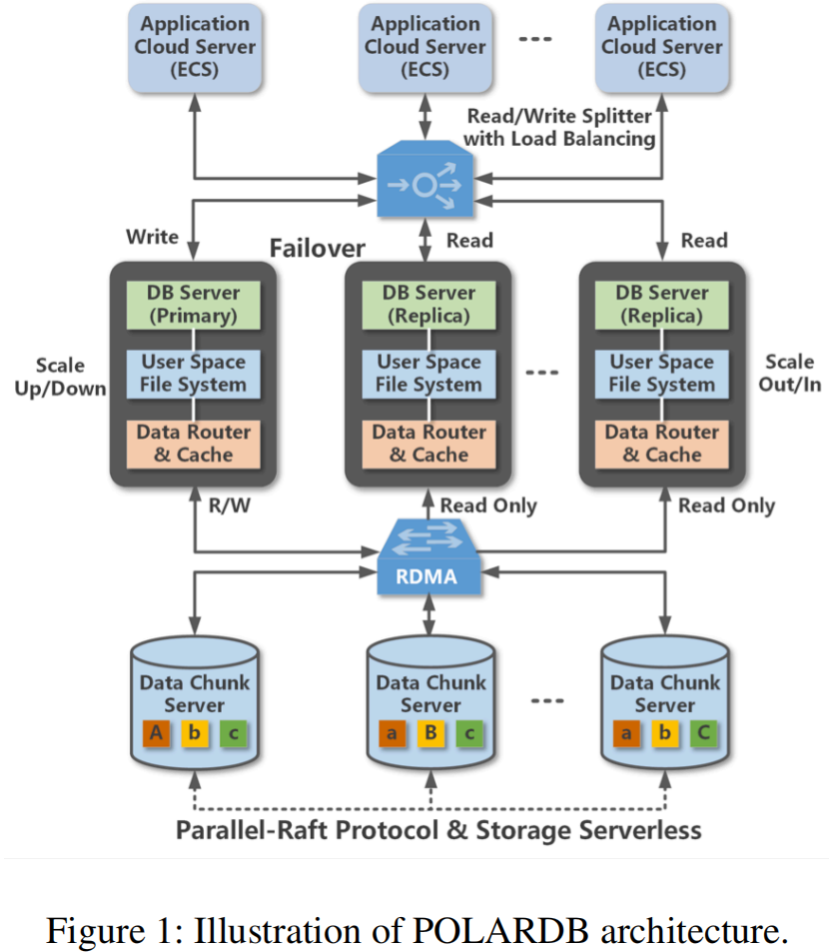
2 Background and Motivation
2.1 POLARDB: Basic Architecture
POLARDB: cloud-native OLTP database designed by Alibaba Cloud. Its design goals come from cloud customers’ real needs: large per-instance storage capacity (tens of TB), high TPS (transactions per second), high and scalable QoS and high availability.
Computing nodes and storage nodes are connected through high-speed RDMA network.
For each database instance, only one read/write database node and the other database nodes handle only read requests.
All the nodes in an instance, including read/write nodes and read-only nodes, are able to access the same copy of data on a storage node.
Parallel-Raft protocol to write three copies of data across the storage nodes.
Shandong University Computer Architecture & Embedded System Research Center

Slide 4
2 Background and Motivation
2.2 POLARDB: Table Scan Pushdown
Cost-effectively equip storage nodes with sufficient data processing power to handle the additional table scan tasks.
Two Options:
(1) Simply scale up each storage node;
Drawbacks:
Table scan over row-store data does not fit well to modern CPU architecture;
(2) Complement storage node CPUs with special-purpose hardware (e.g., FPGA or GPU) that can carry out table scan with much better cost effectiveness;
Drawbacks:
High data traffic;
Data processing hot-spot;
Shandong University Computer Architecture & Embedded System Research Center

Slide 5
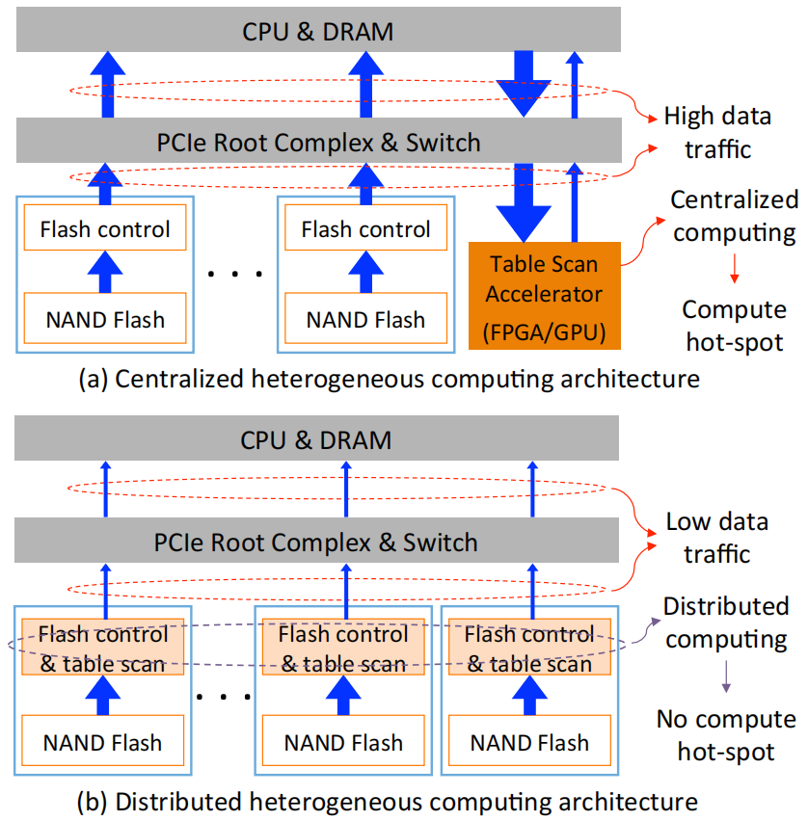
2 Background and Motivation
2.3 Computational Storage Drive
Option Three: a distributed heterogeneous architecture
Problems:
the hardware cost of implementing computational storage drives;
the development cost on developing all the necessary hardware and software solutions;
Choice:
FPGA-based host-managed computational storage drive design strategy.
A single FPGA to realize both flash memory control and computation (i.e., table scan in this work) inside computational storage drives;
The computational storage drive is fully managed by the host for the functions such as address mapping, request scheduling, and garbage collection.
Shandong University Computer Architecture & Embedded System Research Center

Slide 6
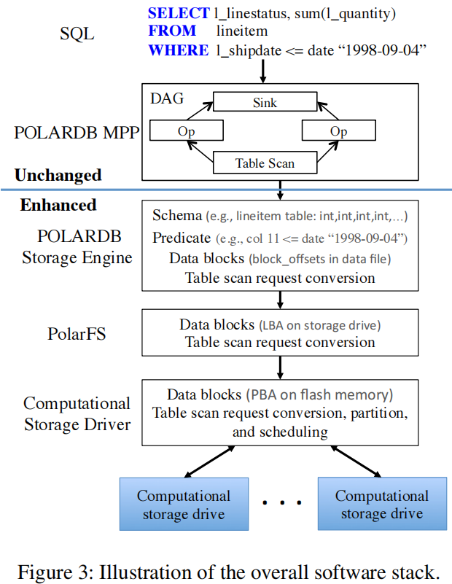
3 Design and Implementation
3.1 Support Table Scan Pushdown Across the Entire Software Stack
3.1.1 Enhancement to POLARDB Storage Engine
Each request contains:
Location(i.e., offsets in files) of the to-be-scanned data;
Schema of the table onto which the table scan is applied;
Table scan conditions to be evaluated;
3.1.2 Enhancement to PolarFS
Decompose the request into m scan requests, each of which scans the data on one computational storage drive;
For each scan request, it converts the data location information into offsets in LBAs;
3.1.3 Enhancement to Computational Storage Driver
The driver exposes each computational storage drive as a block device;
Analyzes and re-arrange scan conditions;
Converts the location information of the to-be-scanned data from the LBA into physical block address (PBA) domain;
Partitions each scan request into smaller scan sub-tasks;
Shandong University Computer Architecture & Embedded System Research Center

Slide 7
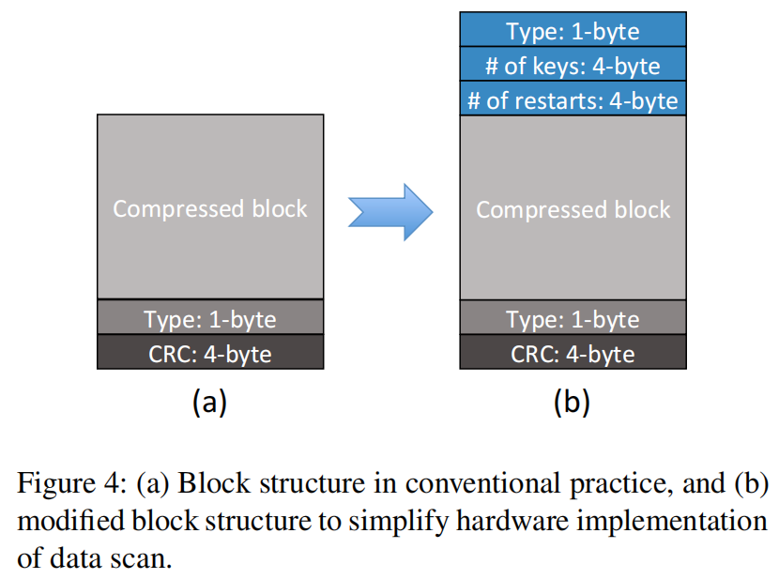
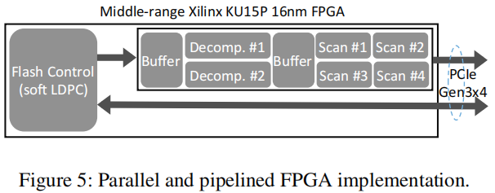
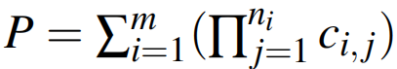
3 Design and Implementation
3.2 Reduce Hardware Implementation Cost
3.2.1 Hardware-Friendly Data Block Format
Modified POLARDB storage engine stores all the table data in the memory-comparable format, data can be compared using function memcmp(). CSD only need to implement a single type of comparator that can carry out the memcmp();
Adding the “# of keys” , “# of restarts” and “1-byte block compression type” fields at the beginning of each block;
3.2.2 FPGA Implementation
Two parallel data decompression engines;
Four data scan engines;
Contains one memcmp module and one RE (result evaluation) module;
Once the value of P (i.e., either 1 or 0) can be determined, the scan engine can immediately finish the evaluation on current row;
Shandong University Computer Architecture & Embedded System Research Center

Slide 8
4 Evaluation
4.1 Experimental Setup
Each drive uses 64-layer 3D TLC NAND flash memory chips. With PCIe Gen3×4 interface, each drive can sustain 2.2GB/s and 3.0GB/s sequential write and read throughput.
Under 100% address span and fully triggered GC, each drive can achieve 160K and 590K random 4KB write and read IOPS, which are on par with the latest enterprise-grade NVMe SSDs.
Each computational storage drive hosts a single mid-range Xilinx UltraScale+ KU15p FPGA chip that handles both flash memory control and computation.
To maximize the error correction strength, each drive supports soft-decision LDPC code decoding with beyond-3GB/s decoding throughput.
The performance evaluation is carried out on a POLARDB instance (with seven database nodes and three storage nodes) in Alibaba Cloud.
Shandong University Computer Architecture & Embedded System Research Center

Slide 9
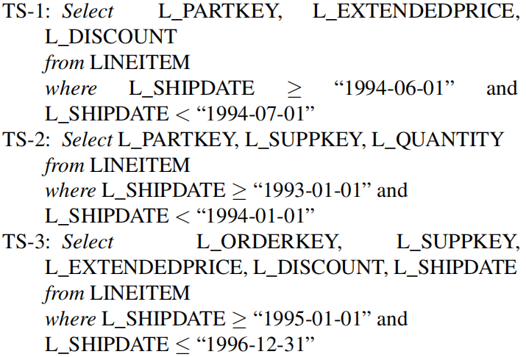
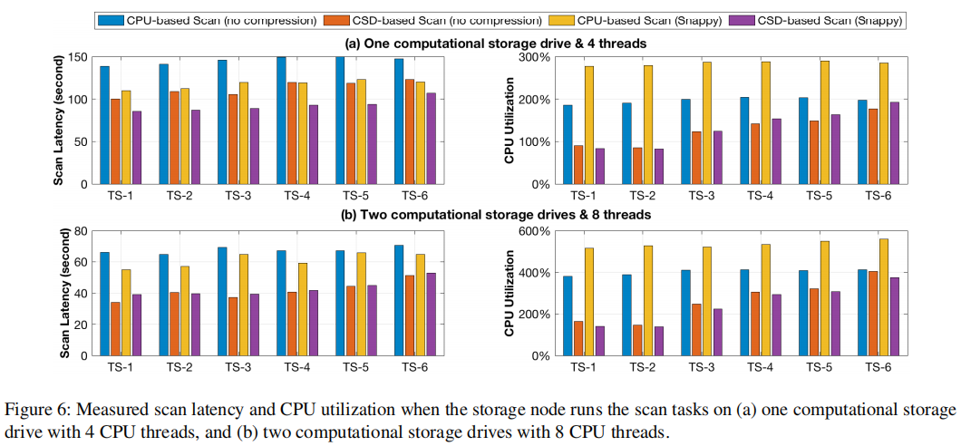
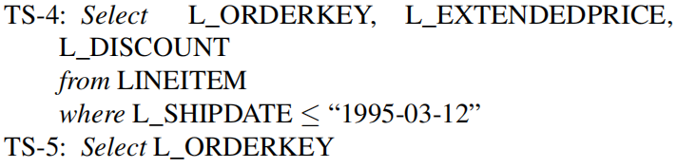
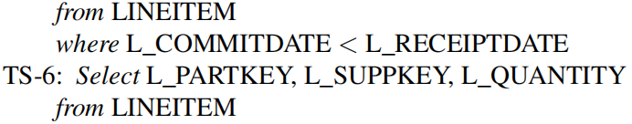
4 Evaluation
4.2 Table Scan Performance Evaluation
the data selectivity in terms of table entries is 1.25%, 15.17%, 30.34%, 54.04%, 63.22%, and 100.00%, respectively
TPC-H: https://www.tpc.org/tpc_documents_current_versions/pdf/tpc-h_v3.0.0.pdf
Shandong University Computer Architecture & Embedded System Research Center

Slide 10
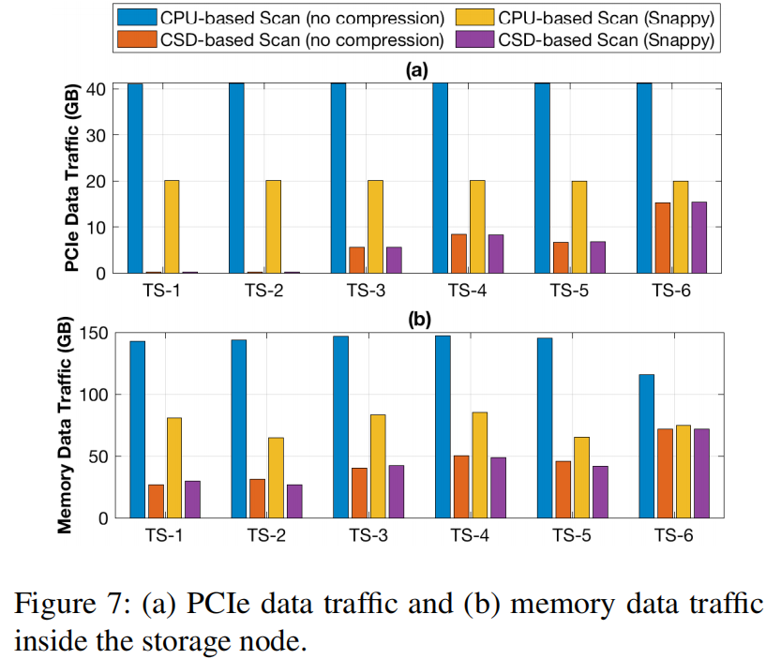
4 Evaluation
4.2 Table Scan Performance Evaluation
the data selectivity in terms of table entries is 1.25%, 15.17%, 30.34%, 54.04%, 63.22%, and 100.00%, respectively
？为什么下边的数量级大
Shandong University Computer Architecture & Embedded System Research Center

Slide 11
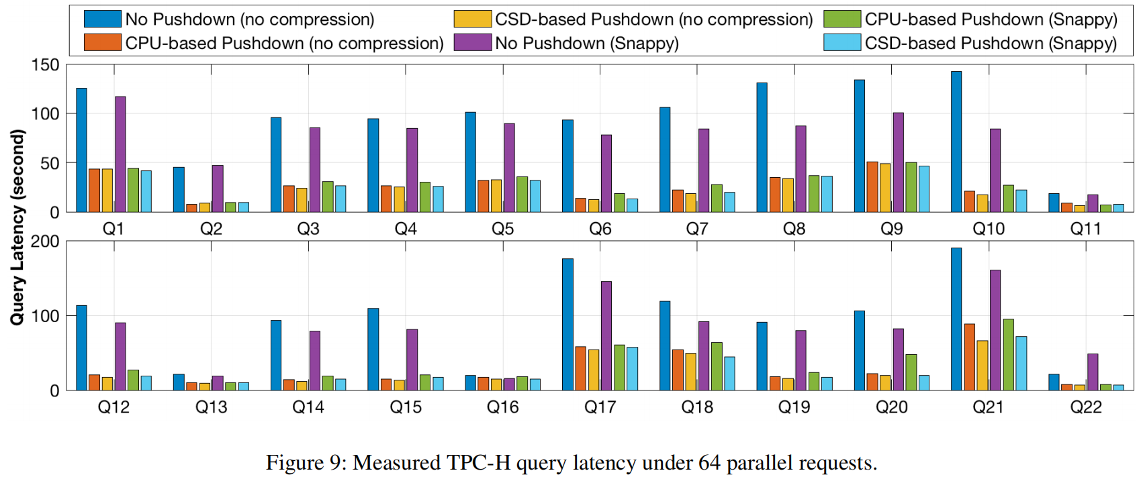
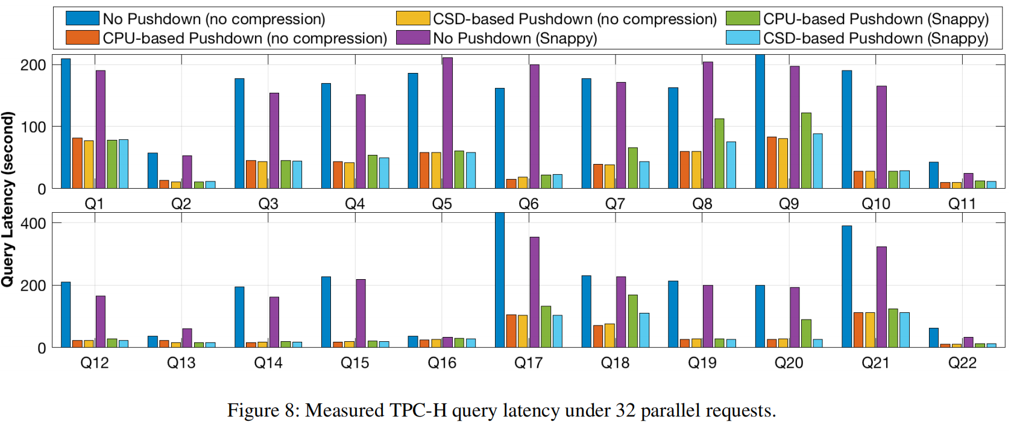
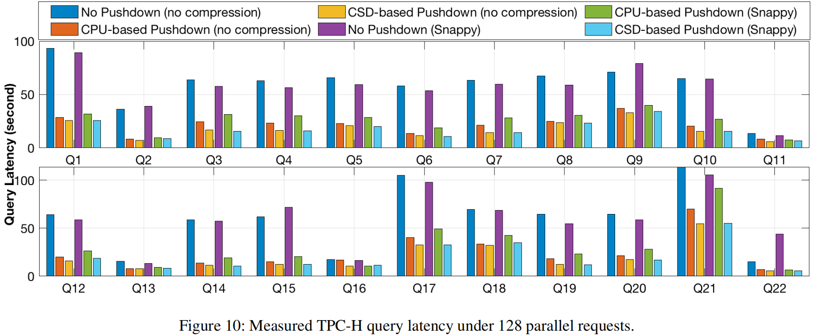
4 Evaluation
4.3 System-level Evaluation
We further ran TPC-H analytical workload benchmark on a POLARDB cloud instance with 32 SQL-engine containers distributed on 7 database nodes and 3 back-end storage nodes. Each storage node hosts 12 computational storage drives,and each drive has a capacity of 3.7TB.
Shandong University Computer Architecture & Embedded System Research Center
Notes:
基于CPU的Push Down和基于CSD的Push Down都可以大幅降低scan操作的延迟。单独比较CPU pushdown和CSD pushdown，我们发现CSD在Q7、8、9、、20明显优于CPU，这是因为FPGA的专用解压缩电路吗？

Slide 12
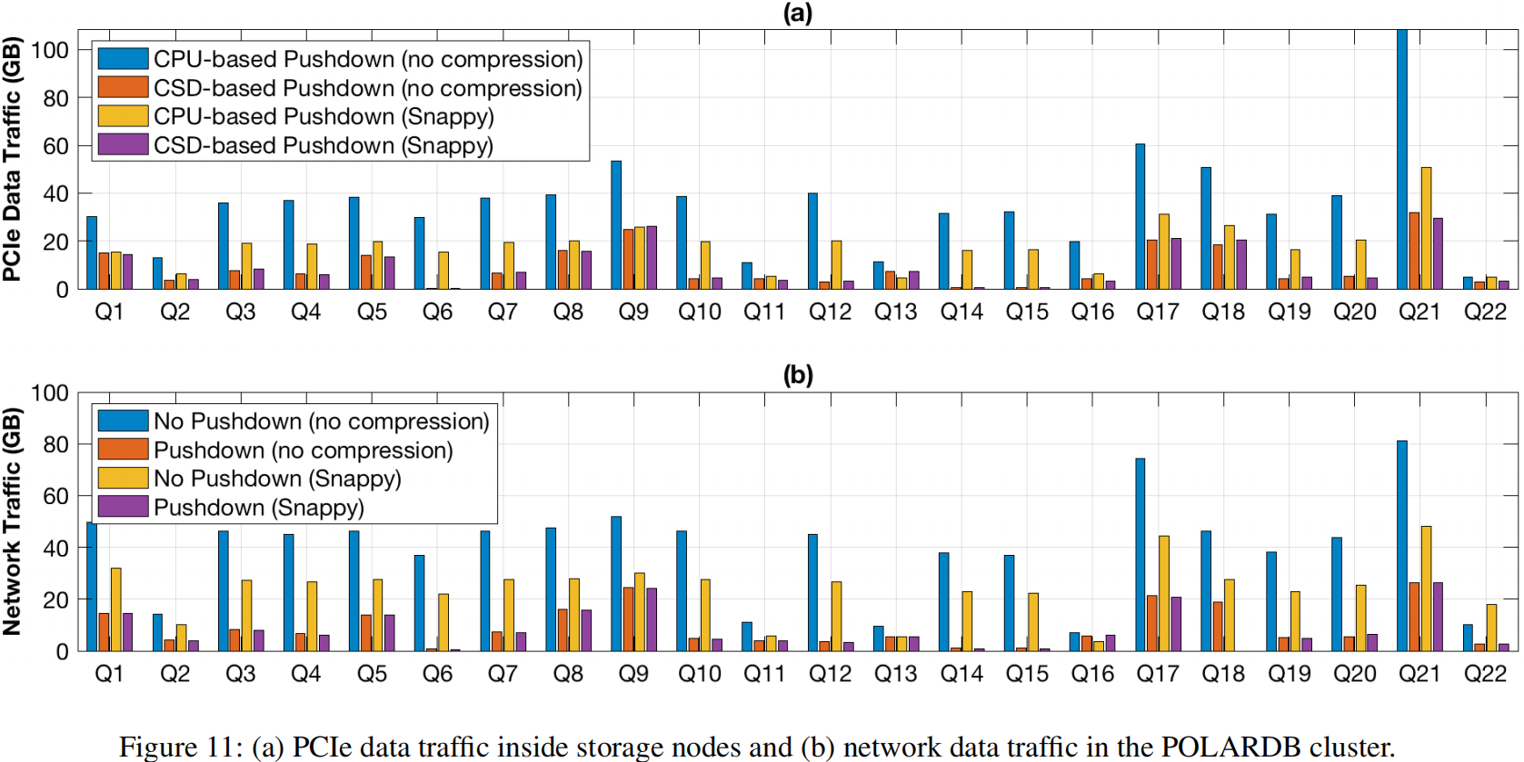
4 Evaluation
4.3 System-level Evaluation
Shandong University Computer Architecture & Embedded System Research Center

